Slide 1
Inventory

Slide 2
Inventory
Inventory of tanks not ships !! For cruise ships, container ships etc use the ‘non cargo’ spaces list to build up a ’menu’ of enclosed spaces for your vessel.
Note the spreadsheet is the inventory not the word document
Listing of all information relating to different types of enclosed spaces information:-
  Regulatory and industry requirements for entry
  Reasons for access in both normal and abnormal/emergency modes
  Assessment of Risk including severity and frequency (qualitative)
  How the hazards of the space are controlled
  Guidance documents
  Risk Matrix
How can it be used now :-
  Gathers all data in one place
  Source of data for work by HEIG
  Provides visibility across all types of spaces and helps to identify themes
How could it be used in the future:-
  Best practice guide for shipowners etc
  Form the basis of a guide or book

Slide 3
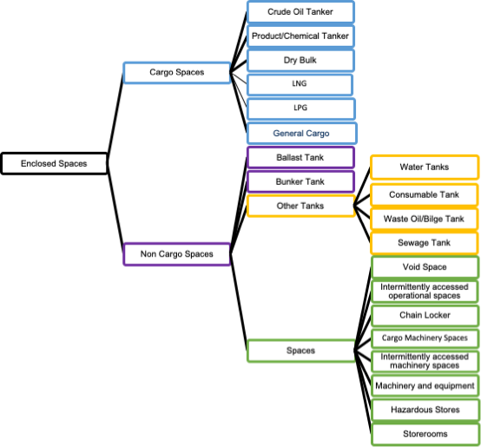

Slide 7
Way Forward
Issues
  Slips and Falls
  Definition
Address the top five riskiest spaces
  Select based on risk
  Hierarchy of Controls
  Proposals
  Use inventory data
  Take ownership and update data and current and future risk.

Slide 8
Time Pressure

Slide 9
Introduction
Commercial Pressure in InterManager study
Ship is an expensive asset in a cyclic business
Profitability depends on maximising earnings and utilisation thus creating time pressure
Commercial Pressure identified in HEIG Matrix
Examples of time pressure
  Titanic
  Herald of Free Enterprise
  Torrey Canyon
Examples of time pressure in enclosed spaces fatalities:-
  Insufficient time between ports to safely gas free and clean tanks/holds
  Urgency to complete maintenance between ports and to effect repairs during load/discharge
  Limited time to prepare tanks/holds for safe entry in port due to port time requirements.
  Perceived pressure from overall workload
But a well run, well designed ship, with sufficient manning can do things quickly

Slide 10
Protection Vs Performance

Slide 12
Perceived Time Pressure
Perceived by all involved in ship operation:
  Fear of losing job.
  Power-distance culture / fear to challenge
  Organisational culture of taking short-cuts
  Desire for promotion
  Good feeling of doing tasks under time pressure and being praised by management
  Pressure of handover
  Peer pressure
  Done it before under time pressure and want to replicate again

Slide 13
Fast Thinking
Fast thinking is automatic, frequent, emotional, stereotype
Saves time and sometimes its works
Prone to errors
We are mostly unaware if we are applying fast thinking or slow thinking unless someone else tells us or we sit down, take time and think
Examples
  Rescuing affected seafarers
  Frequent tank entry may reduce perception of risk among seafarers onboard chemical tankers; seafarers may take short-cut under time pressure thinking that they will be safe
  May enter into void spaces next to chemical cargo tanks with less precaution under time pressure thinking that void spaces are not so dangerous

Slide 14
Way Forward
Contracts and industry practice
Fast and Slow thinking
Eliminate, substitute and engineering control strategies

